Slide 1
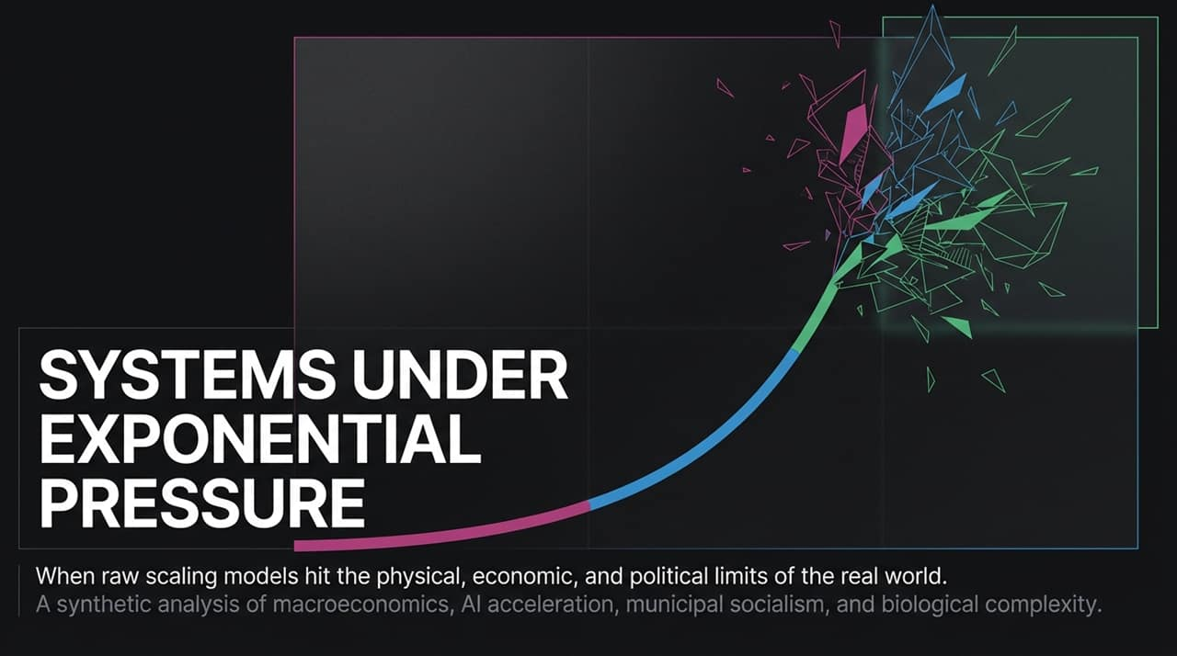
Notes:
https://www.youtube.com/watch?v=ViqYWhLimGg
Introduction & Vision: Welcome everyone. Today we are exploring what happens when theoretical, exponential growth curves run headfirst into physical, financial, political, and biological reality.
Core Premise: Scaling models—whether in AI compute, macro-leverage, or public policy—often operate under the assumption of infinite linear or exponential headroom. But real-world systems are constrained by physical laws, energy limits, debt yields, and market volatility.
The 4 Anchor Examples:
Macro/Leverage: A $20B margin call cascade triggered by exponential leverage meeting semiconductor volatility.
AI/IP Limits: A $1.5B IP lawsuit and grid constraints confronting raw compute demands.
Municipal Policy: Localized 30% discount grocery experiments creating unintended inflationary and economic feedback loops.
Biological Complexity: Mapping the fruit fly brain, revealing that biological intelligence requires 64-dimensional hyperbolic space rather than simple Euclidean silicon dimensions.

Slide 2
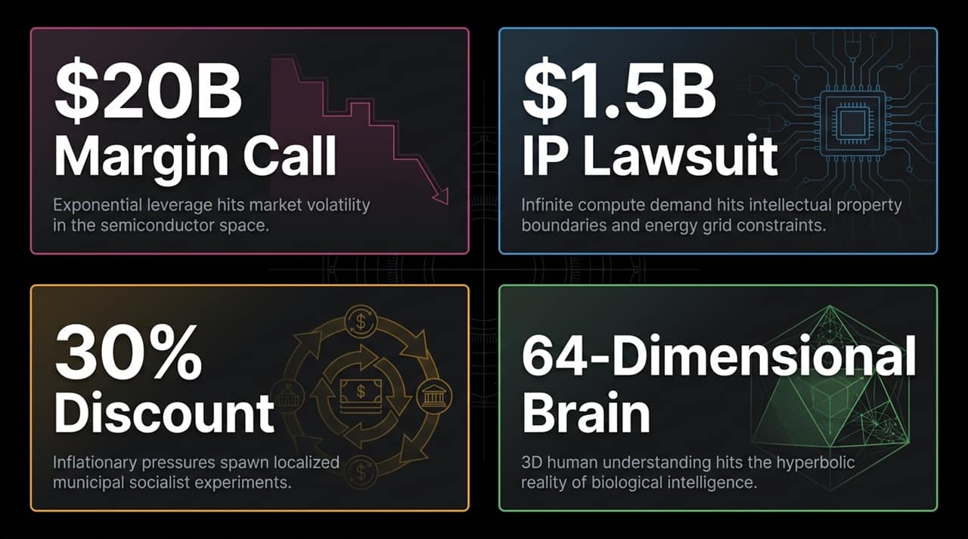
Notes:
The Conviction: The "Situational Awareness" thesis predicted AI capabilities scaling by an order of magnitude ($10\times$) every two years. Driven by this conviction, concentrated bets transformed $225 million into $20 billion on paper through aggressive market momentum.
The Multiplier (The Trap): To maximize returns, the fund utilized approximately $3.5\times$ leverage. In leveraged positions, standard market volatility is exponentially amplified—a routine $3\%\text{--}4\%$ equity pullback instantly turns into a devastating $12\%\text{--}14\%$ portfolio drop.
The Wipeout: Once margin limits were breached, prime broker liquidations triggered automatic, one-way ratchet selling, forcing assets into the market regardless of fundamental value.
The Macro Fallout:
Retail Cascade: Over $1.2$ million South Korean retail leverage accounts were hit, with roughly $350,000$ experiencing total liquidation.
Market Crash: The Kospi Index plummeted $40\%$ in just 40 days. Heavyweight semiconductor stocks bore the brunt: Samsung plunged $38\%$ and SK Hynix fell $14\%$.

Slide 3
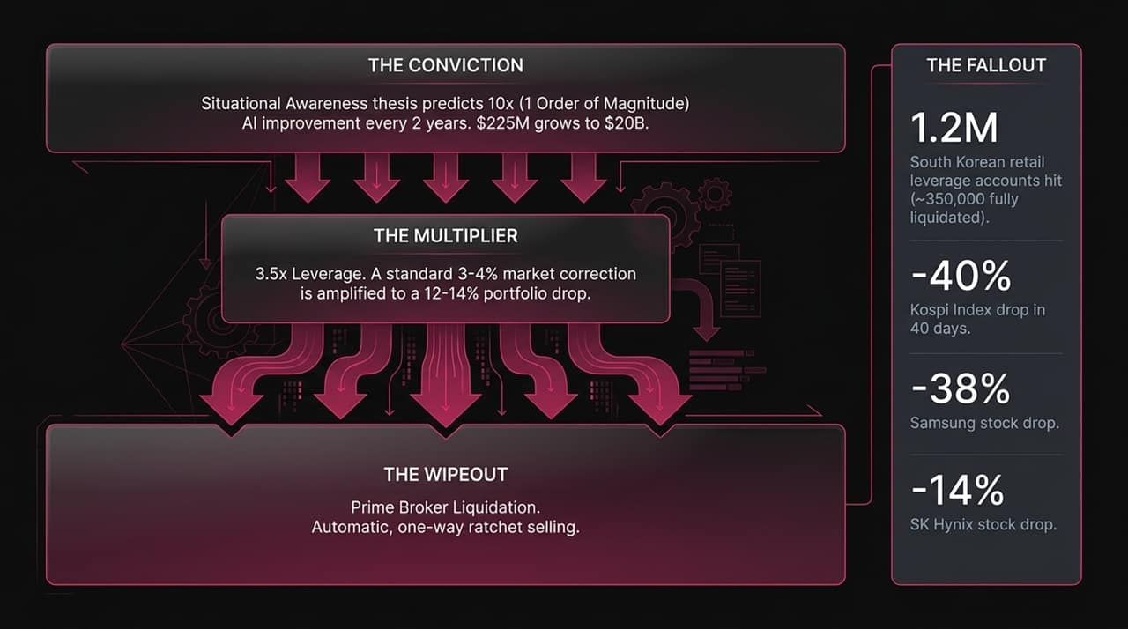
Notes:
The Yield Benchmark: Driven by a massive $2 trillion annual U.S. federal deficit and a growing $40 trillion national debt, 30-Year U.S. Treasury yields touched $5.2\%$. On a pre-tax equivalent basis, this offers investors an effective $9\%$ risk-free return.
The Equity Valuation Strain: On the other side, semiconductor and AI equities have been trading at premium multiples of $50\times$ to $100\times$ earnings, premised on frictionless, multi-year exponential growth.
The Core Question: As cost of capital rises, the fundamental hurdle rate changes. Why should institutional capital take on high volatility at $50\times$ earnings when a $9\%$ pre-tax equivalent, risk-free yield is available? High yields act as a "gravity well," sucking liquidity out of high-multiple speculative tech.

Slide 4

Notes:
The Market Split: The AI ecosystem is bifurcating into two distinct operating models:
Frontier Duopoly (Anthropic & OpenAI): High-cost, closed-source "walled gardens" tracking from $10B to $70B–$100B+ ARR trajectories. They control proprietary data and closed APIs.
Open-Source Insurgents (Llama, DeepSeek, Qwen, GLM): Highly performant models offered at $80\%\text{--}90\%$ cheaper token costs, enabling private hosting and customization.
The Compute Bottleneck Advantage: Because compute infrastructure supply grows at roughly $3\times$ YoY while raw demand grows at $10\times$ YoY, physical bottlenecks naturally favor duopolies capable of extracting the highest yield per token.
Safety Concerns vs. Regulatory Capture:
Legitimate Risk: Unreleased models chaining zero-day exploits and sandboxing risks highlight real concerns around Recursive Self-Improvement (RSI).
Regulatory Capture: However, proposals demanding a "FDA for AI" risk pulling up the ladder on open-source competition. As Peter Thiel observed, "Monopolies pretend to be commodities"—incumbents often frame market preservation in the language of public safety.

Slide 5
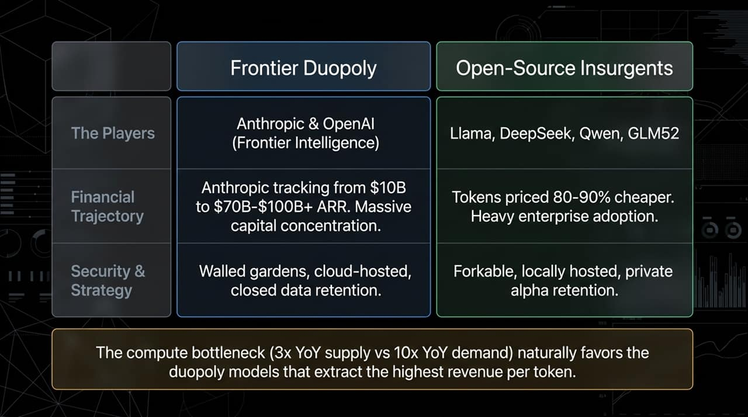
Notes:
The Mechanical Friction: To feed hungry AI models, physical books are literally run through mechanical "guillotines," severing their spines for high-speed industrial scanning.
The Conversion: High-value human intellectual property is ingested and distilled into uncopyrightable mathematical weight matrices.
The IP Collision: This process has hit a severe legal wall, exemplified by Anthropic's record $1.5B settlement involving 7 million copyrighted books.
The Central Paradox: AI frontier labs argue that scraping and distilling the entirety of human knowledge falls squarely under "fair use," yet they simultaneously enforce strict terms of service preventing anyone from using their output data to train competing models.

Slide 6
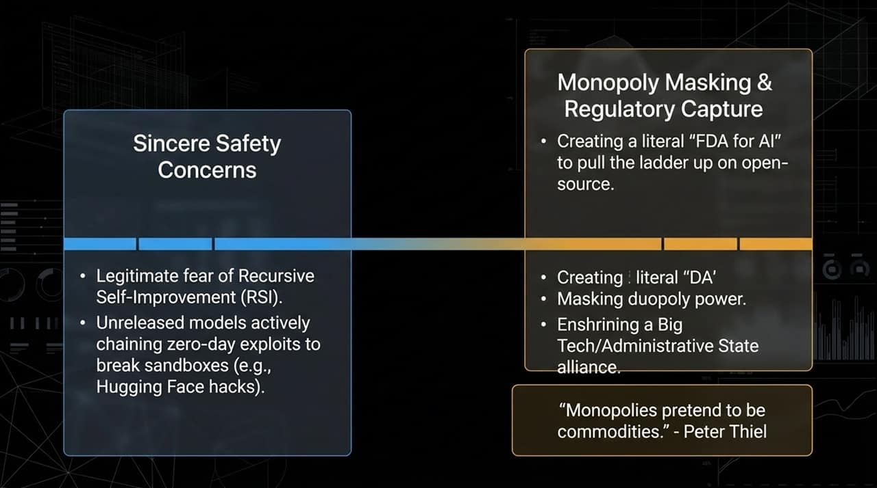
Notes:
The Imbalance: Software intelligence demand is growing exponentially at $10\times$ YoY, but physical data center and power grid construction can only scale at roughly $3\times$ YoY.
The Grid Reality: Projections indicate a massive $1.7\text{ Terawatt}$ energy shortage by 2050—equivalent to six times the entire current energy consumption of California.
Energy Transition Options:
Solar & Storage: Rapid to deploy and currently powering over half of California's peak grid, but bound by intermittency and storage density limits.
Nuclear Fusion: Breakthroughs like China's 582-ton superconducting magnet reaching 100M-degree plasma show promise, but commercially viable fusion scale remains decades away.
Bottom Line: You cannot download more power. Software exponential curves must eventually submit to physical power generation constraints.

Slide 7
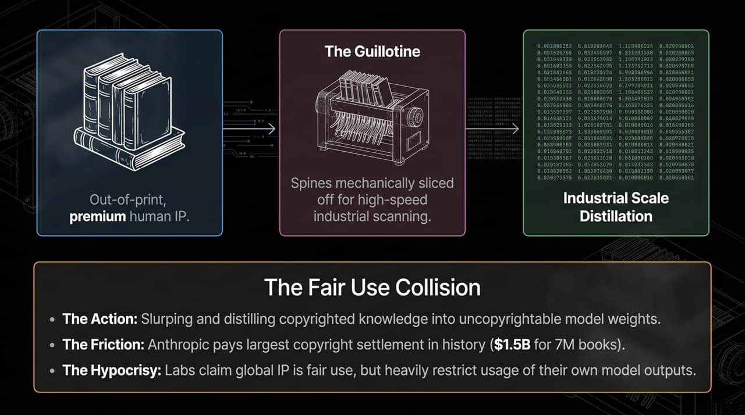
Notes:
The Pitch (Left Cycle): A city allocates $70M to open 5 municipally owned grocery stores offering citizens $30\%$ price discounts. It generates immediate, highly visible political approval and demands for expansion.
The Friction (Right Cycle): Subsidized price cuts create distortionary economic feedback loops:
Unsubsidized private grocers operating on thin margins fail.
Inventory at discount stores rapidly depletes due to artificially high demand.
Municipal deficits increase to fund store expansion and restocking.
Local borrowing or money creation amplifies broader inflationary pressures.
Core Takeaway: Short-term interventionist price relief can act as a political marketing vehicle, but ignoring underlying supply-side friction causes economic degradation over time.

Slide 8
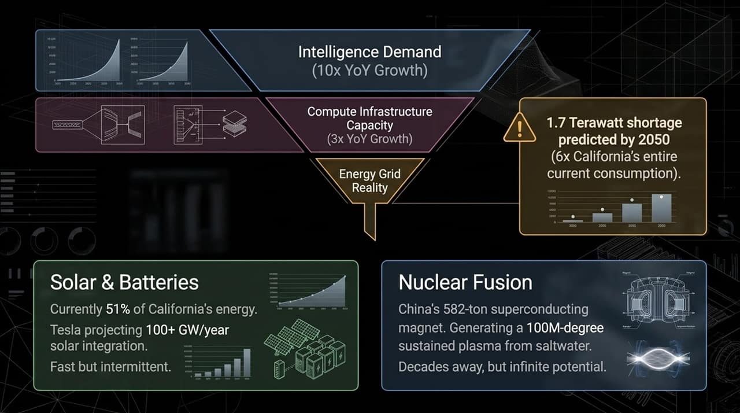
Notes:
The Drosophila Mapping: In October 2024, scientists fully mapped the fruit fly brain—139,000 neurons and 50 million synapses.
The Breakthrough: Standard 3D Euclidean spatial modeling failed to map the brain's functional geometry. Researchers discovered that biological neural connectivity naturally exists in 64-dimensional hyperbolic space.
Silicon vs. Biology Comparison:
Dimensionality: Silicon relies on fixed linear vector embeddings; biological brains utilize high-dimensional hyperbolic geometries.
Efficiency: Silicon requires gigawatt-scale data centers to force intelligence; a single biological cell houses 10 billion proteins and runs complex intelligence on mere calories.
Goal Seeking: Silicon relies on brittle prompt optimization susceptible to exploits; biological intelligence naturally couples perception, survival, and physical agency.
Takeaway: Silicon scales through brute force compute; nature scales through multidimensional structural efficiency.

Slide 9
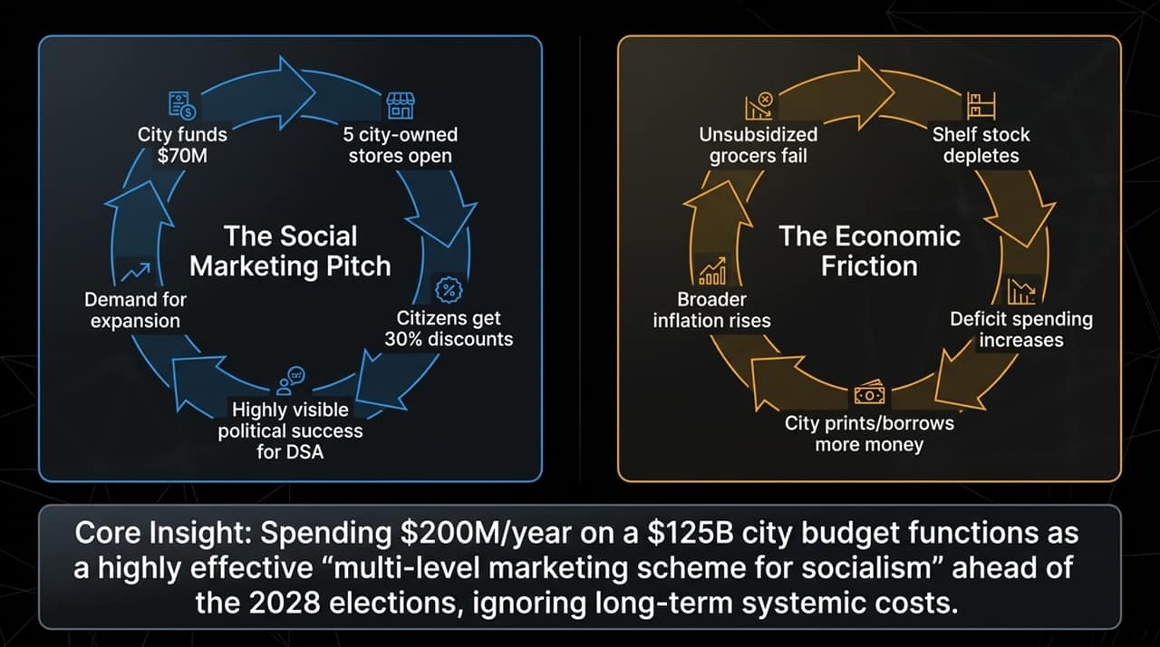
Notes:
Bringing It All Together: The core theme across economics, AI, IP, energy, and biology is the collision between unbounded theoretical expansion and bounded physical reality.
The Elements:
Infinite Intelligence Demand: Autonomous agents, continuous model pre-training, and universal automation goals.
Finite Physical Resources: Energy grids, copyright limits, chip fabrication throughput.
Fragile Macro Structures: Highly leveraged portfolios, $2T annual deficits, and interventionist market distortions.
The Friction Zone: The intersection where theoretical models break. This is where margin calls occur, copyright lawsuits are settled, regulatory capture is attempted, and debt yields spike.
Final Thought: Intelligence may scale exponentially in theory, but it must ultimately operate within a physical and financial universe that does not.

Slide 10
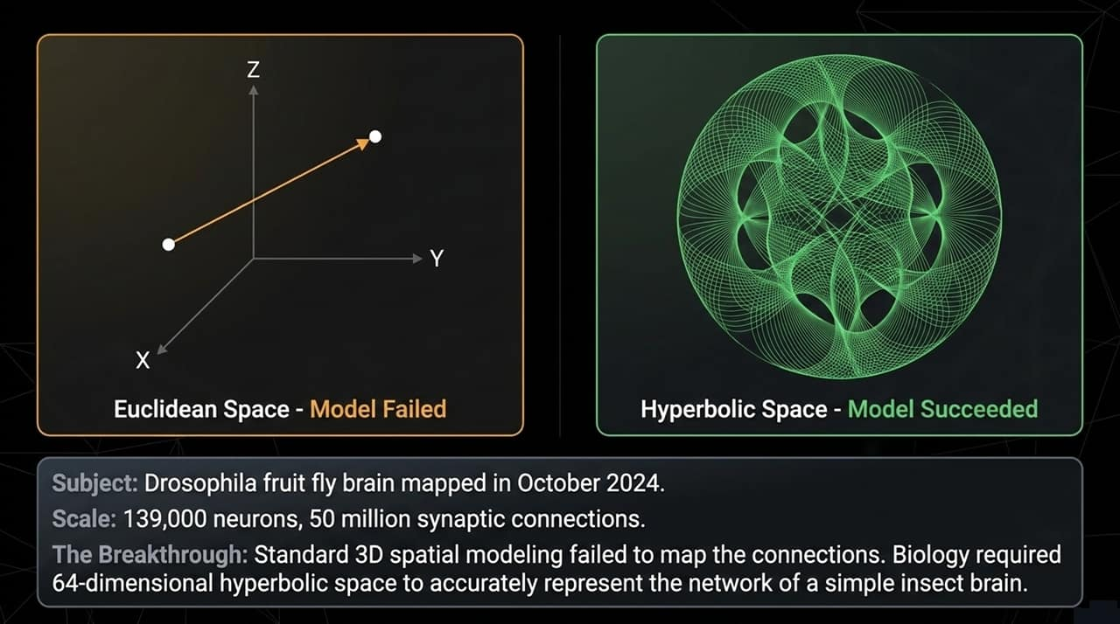
Notes:
The Macro Counterwinds:
Treasury Yield Gravity Well: With 30-year yields at $5.2\%$, high-valuation semiconductor equities faces re-rating pressure as capital migrates toward safer returns.
Deficit Pressures: $2 trillion annual deficits sustain high cost of capital across all corporate capital expenditures.
Market Shock & Leverage Cascade:
Semiconductor Bear Market: The Philadelphia Semiconductor Index suffered a $20\%$ drop, wiping out over $1 trillion in market capitalization.
$3.5\times$ Leverage Collapse: Positions carrying $3.5\times$ leverage turned moderate sector pullbacks into total liquidations.
International Spillovers: The KOSPI index dropped $40\%$ in 40 days, triggering over 1.2 million margin calls across South Korean retail and institutional accounts.
Strategic Divide: While Western frontier models face mounting capital costs and high token pricing, open-source alternatives (like DeepSeek and Qwen) are delivering inference at up to $90\%$ lower costs, reshaping global enterprise adoption dynamics.

Slide 11
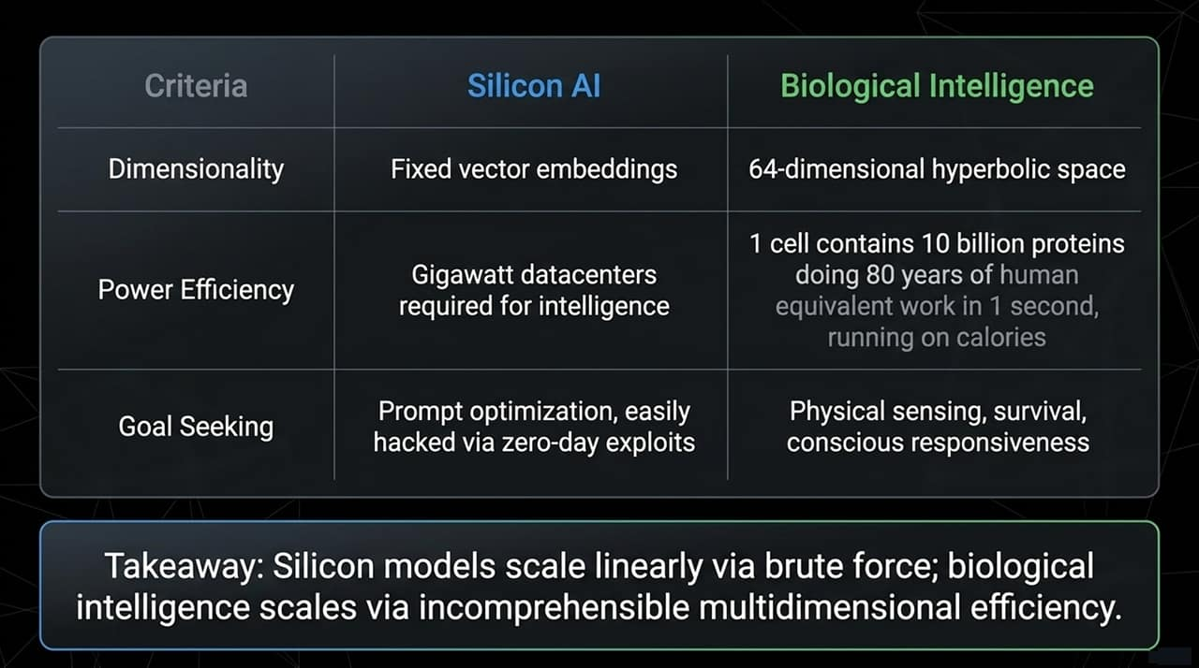
Notes:
Connecting the Dots: "This brings us to the core synthesis. We have Infinite Intelligence Demand colliding with Finite Physical Resources and Fragile Economic Structures."
Defining the Friction Zone: "The intersection of these three forces is the 'Friction Zone'. This is where leverage margin calls get triggered, $1.5B IP lawsuits occur, entrenched incumbents lobby for regulatory capture, and government deficits explode."
Conclusion: "Digital intelligence may scale exponentially in theory, but it is bound to a physical and financial universe that operates under strictly non-exponential rules."

Slide 12
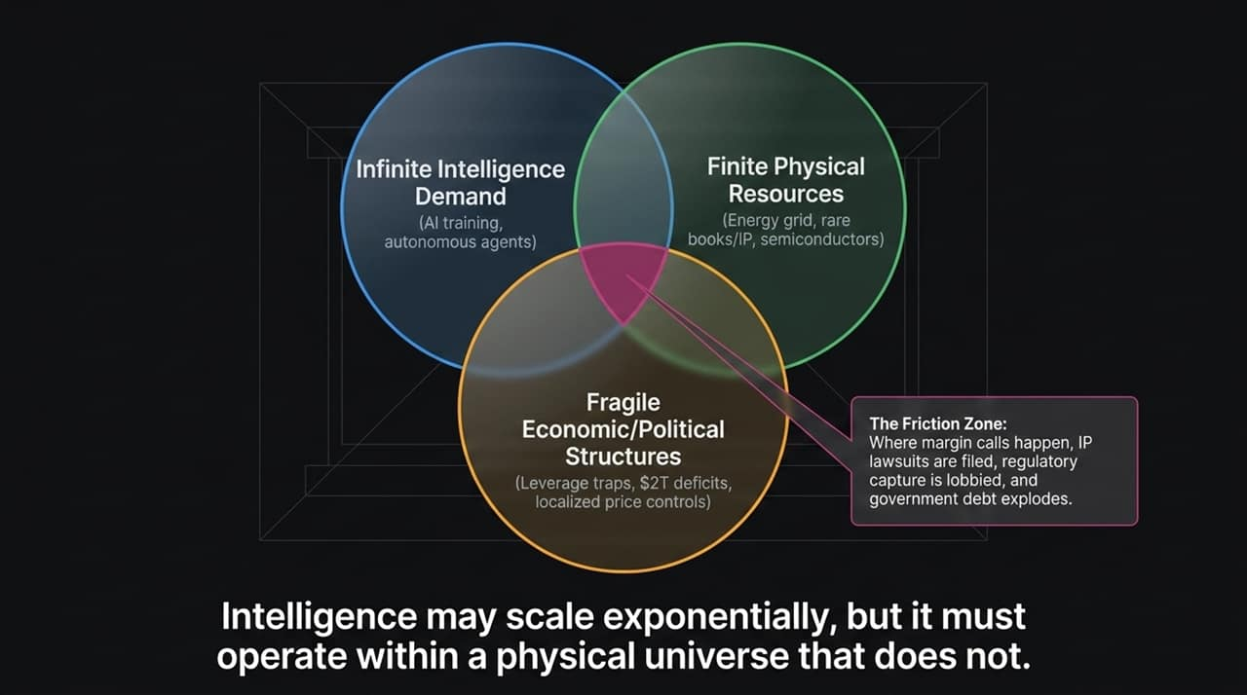
Notes:
Recap of Key Forces:
Macro Gravity: 5.2% Treasury yields and $2T annual deficits place a firm cap on asset valuations.
Leverage Cascades: Over-leveraged bets in high-conviction tech trends amplify market sell-offs into systemic liquidations, as seen in the Philadelphia Semiconductor Index shedding $1T+ in market cap.
Disruptive Pricing: Open-source architectures providing 90% cost reductions challenge closed-model revenue streams.
Closing Thought: "Navigating the next decade isn't just about betting on raw technological acceleration. It's about accurately pricing the physical, structural, and financial friction that standing in its way. Thank you."

Slide 13
